Slide 1
Genetic Algorithms for Best Possible Flight (INFO6205_08)
Team 08
Hardik Jain
Shikha Shah

Slide 2
Table Of Contents
Problem Statement
Overview
Approach
Output
Test Cases
Result
Conclusion

Slide 3
Problem Statement
The Genetic Algorithm focusses on finding the best possible flight from one city to another.
The fitness of a particular flight is defined by the time it takes and the price of a ticket on the flight.
The best flights from a particular population are chosen for crossover leading to better flights.
Each iteration leads to the creation of a new generation which leads to creation of new off springs.
The logger displays the fitness of the new species, the fitness of the one culled in that iteration and the fitness of the new species before and after mutation if mutation takes place.

Slide 4
Genetic Algorithms

Slide 5
Overview
We are taking flights whose chromosomes and traits are based on time taken and prize.
Fitness function is evaluated based on time and cost of flight.
Selection is made on the basis of top two fittest flight in terms of time and prize to produce the offspring.
Crossover and mutation is done post selection.

Slide 6
Genetic Code
public void genearateTimeArray() {
int size = timeArray.length;
for (int i = 0; i < size; i++) {
double random = Math.random();
timeArray[i] = (int)Math.round(random);
}
}
public void genearatePriceArray() {
int size = priceArray.length;
for (int i = 0; i < size; i++) {
double random = Math.random();
priceArray[i] = (int)Math.round(random);
}
}
We are using random number generator to develop chromosomes/ traits for flights.

Slide 7
The price step value gets added to the base price value for every element 0 in the price array. Changes to the above values can be made in the constants file
public int getPrice() {
int price = Constants.BASE_PRICE;
for (int i = 0; i < priceArray.length; i++)
price = priceArray[i] == 0 ? price + Constants.PRICE_STEP : price;
return price;
}
The same goes for base time value.

Slide 8
Fitness Function
public Integer calculateFitness() {
int fitness = 0;
for (int i = 0; i < timeArray.length; i++) {
if (timeArray[i] == 1)
++fitness;
if (priceArray[i] == 1)
++fitness;
}
this.fitness = fitness;
return fitness;
}
Fitness function, for this case is number of 1s present in the genome.

Slide 9
Comparison of different flights based on fitness function
public int compareTo(Flight o) {
Integer fit1 = calculateFitness();
Integer fit2 = o.calculateFitness();
if (fit1 - fit2 > 0)
return -1;
else if (fit1 - fit2 < 0)
return 1;
else
return 0;
}
Different flights are compared based on fitness function, for eg. flightA whose fitness function is 7 is considered to be more fit than flight whose fitness function is 5

Slide 10
Selection
private void doSelectionAndCrossover() {
int cullCount = (int)(Constants.CULL_RATIO * flights.size());
for(int i = 1; i <= cullCount; i++) {
//Choosing the 2 best species
Flight flight1 = getFittest();
Flight flight2 = flights.get(1);
Flight newFlight = doCrossover(flight1, flight2);
doMutation(newFlight);
doCull();
}
}
For each evolution, a certain percentage of the population gets culled based on the cull ratio and the same number of offspring are added.

Slide 11
Crossover
private Flight doCrossover(Flight flight1, Flight flight2) {
Flight newFlight = generateFlight();
int cutoff = (int)Math.floor(Math.random() * 10);
int size = flight1.getTimeArray().length;
int[] priceArray = newFlight.getPriceArray();
int[] priceArray1 = flight1.getPriceArray();
int[] priceArray2 = flight2.getPriceArray();
int[] timeArray = newFlight.getTimeArray();
int[] timeArray1 = flight1.getTimeArray();
int[] timeArray2 = flight2.getTimeArray();
for(int i = 0; i < size; i++) {
if(i <= cutoff) {
priceArray[i] = priceArray1[i];
timeArray[i] = timeArray1[i];
}
else {
priceArray[i] = priceArray2[i];
timeArray[i] = timeArray2[i];
}
}
newFlight.calculateFitness();
logger.info("New fitness : " + newFlight.getFitness());
return newFlight;
}

Slide 12
Mutation and Cull
private void doMutation(Flight flight) {
if(Math.random() < 0.08) {
logger.info("Fitness before mutation : " + flight.getFitness());
int bit = (int) Math.floor(Math.random() * 10);
flight.getPriceArray()[bit] = flight.getPriceArray()[bit] == 0 ? 1 : 1;
flight.getTimeArray()[bit] = flight.getTimeArray()[bit] == 0 ? 1 : 1;
logger.info("Fitness after mutation : " + flight.calculateFitness());
logger.info("");
}
private void doCull() {
Collections.sort(flights);
Flight remove = flights.remove(flights.size() - 1);
logger.info("Culling fitness : " + remove.getFitness());
}

Slide 13
Crossover and Mutation
Cutoff is calculated by random number generation
A new breed of flight is generated till the time i(loop through size of time array(trait) becomes smaller than cut off value then, genes from most fittest flight is taken and when i value becomes greater than cut off value, genes from 2nd most fitted flight is taken into consideration.
Mutation is done using random number generator, it checks for the genes after crossover, if its zero, it turns them to 1.

Slide 14
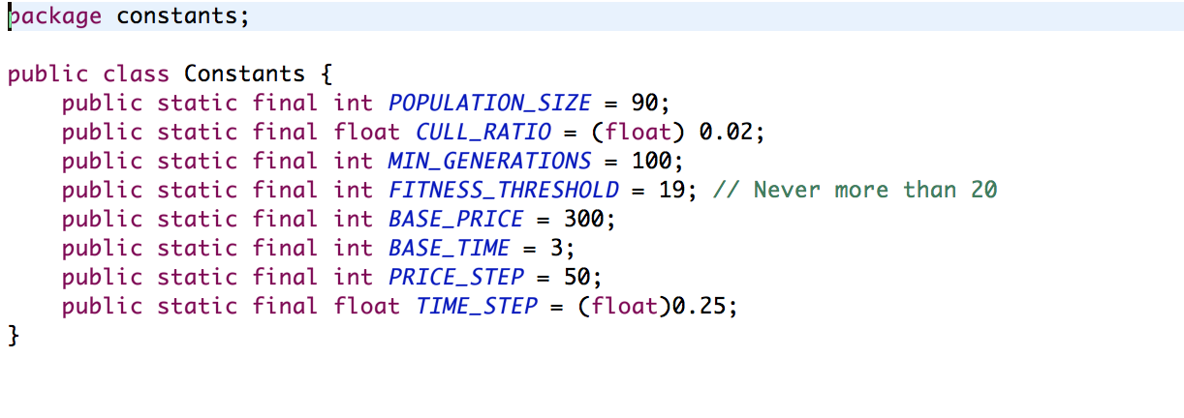
Constants File
Constant files consist of various parameters whose values are pre-defined.

Slide 15
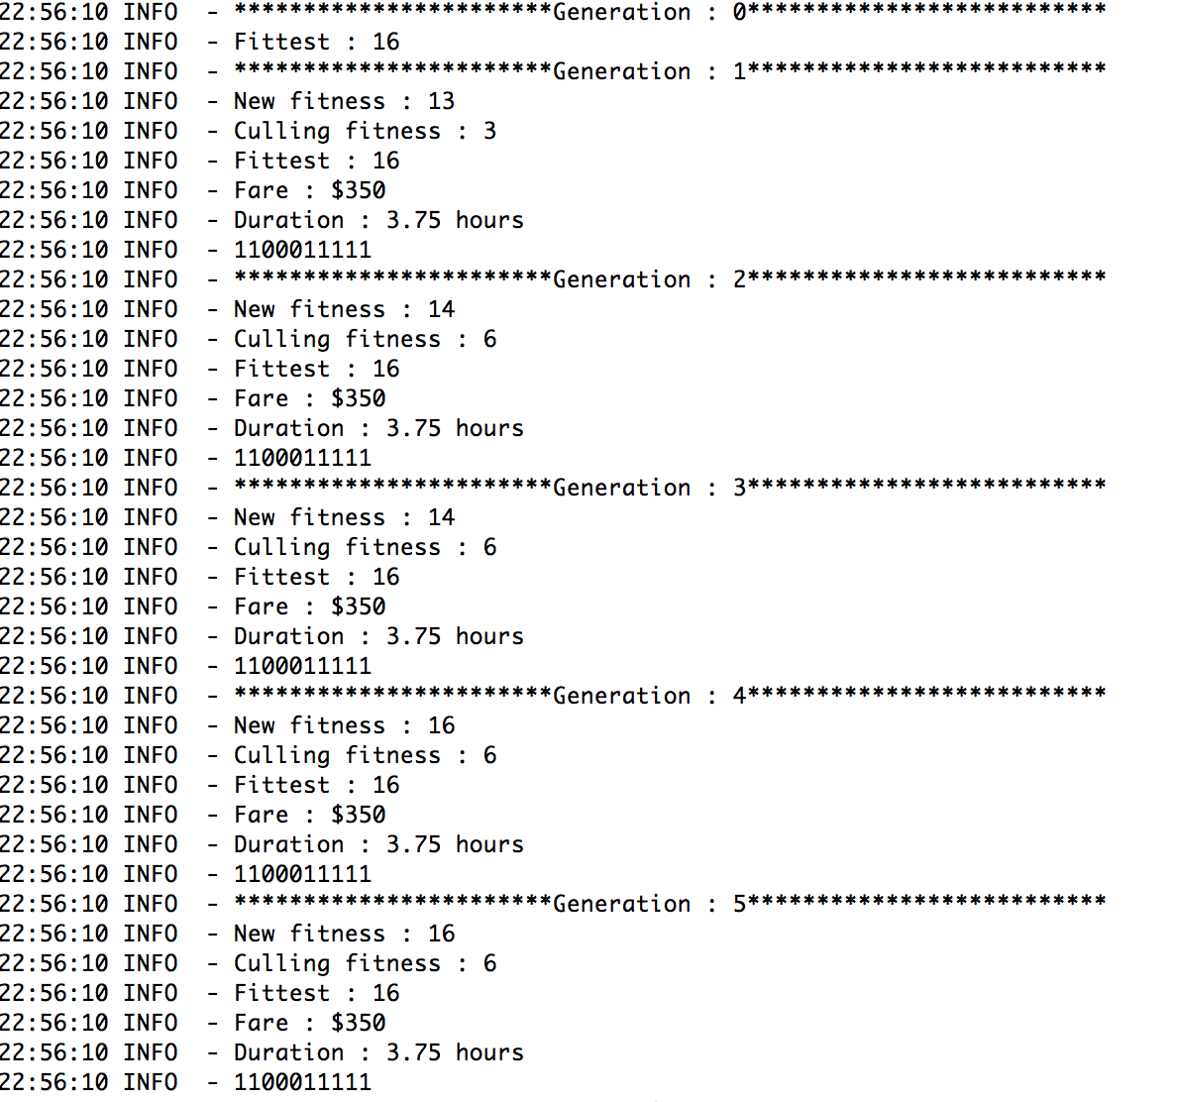
Outputs

Slide 16
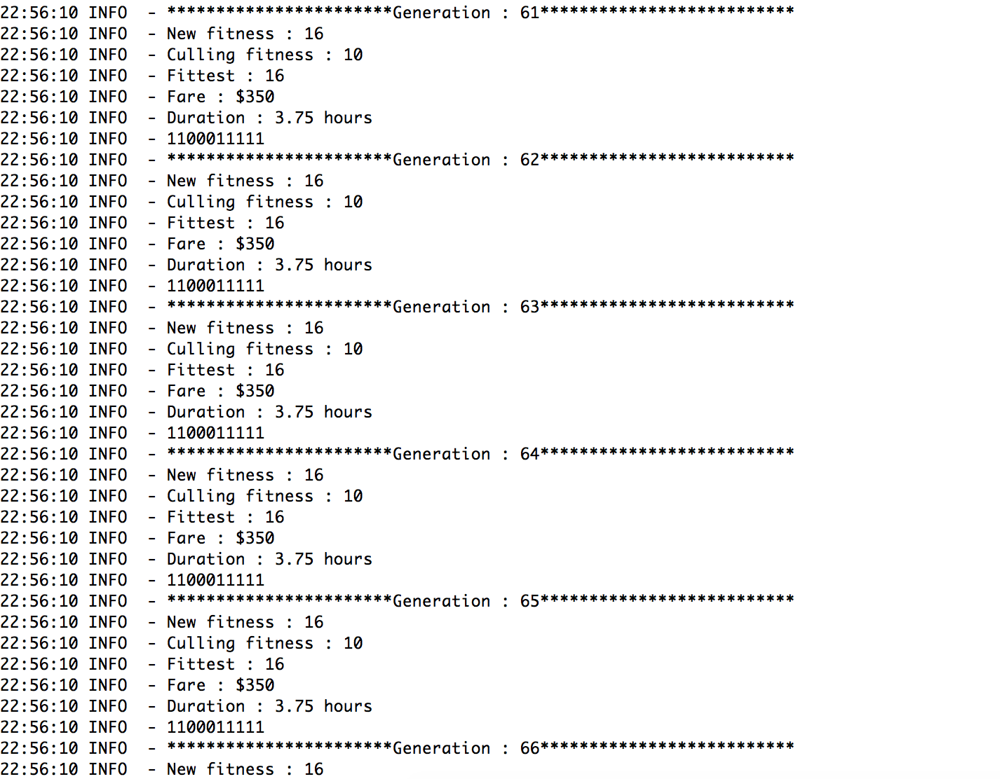
Outputs

Slide 17
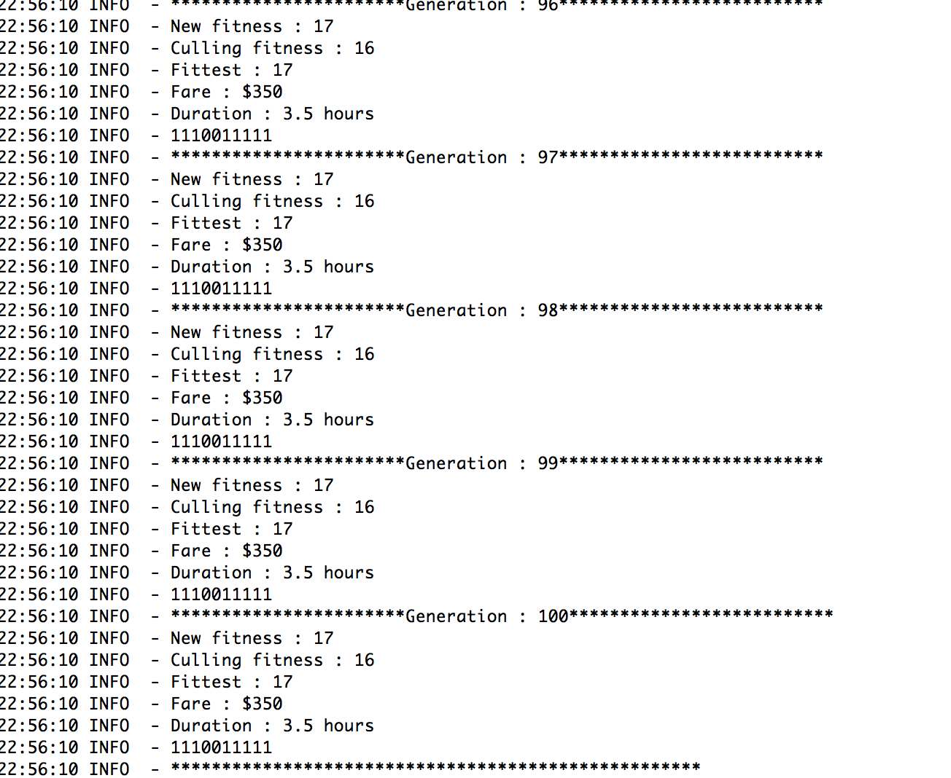
Outputs

Slide 18
Unit Tests
@Test
 | public void testFitness2() {
 | int[] priceArray = {1,1,0,0,0,1,1,0,0,1};
 | int[] timeArray = {1,0,1,0,0,0,0,0,0,1};
 | Flight flight = new Flight();
 | flight.setPriceArray(priceArray);
 | flight.setTimeArray(timeArray);
 | assertEquals(flight.getFitness(), 8);
 | }
 | @Test
 | public void testFlight() {
 | Population pop = new Population();
 | pop.generatePopulation();
 | assertEquals(pop.getFlights().size(), Constants.POPULATION_SIZE);
 | int tries = 1;
 | while (tries <= Constants.MIN_GENERATIONS || pop.getFittest().getFitness() < Constants.FITNESS_THRESHOLD) {
 | pop.evolve();
 | tries++;
 | }
 | assertTrue(pop.getFittest().getFitness() >= Constants.FITNESS_THRESHOLD);
 | }

Slide 19
Unit Test
@Test
 | public void testFitness() {
 | Flight flight = new Flight();
 | assertEquals(flight.getFitness(), 0);
 | }
 | @Test
 | public void testFitness1() {
 | int[] priceArray = new int[] {0,0,0,0,0,1,1,0,0,1};
 | int[] timeArray = new int[] {0,0,1,0,0,0,0,0,0,1};
 | Flight flight = new Flight();
 | flight.setPriceArray(priceArray);
 | flight.setTimeArray(timeArray);
 | assertEquals(flight.getFitness(), 5);
 | }

Slide 20
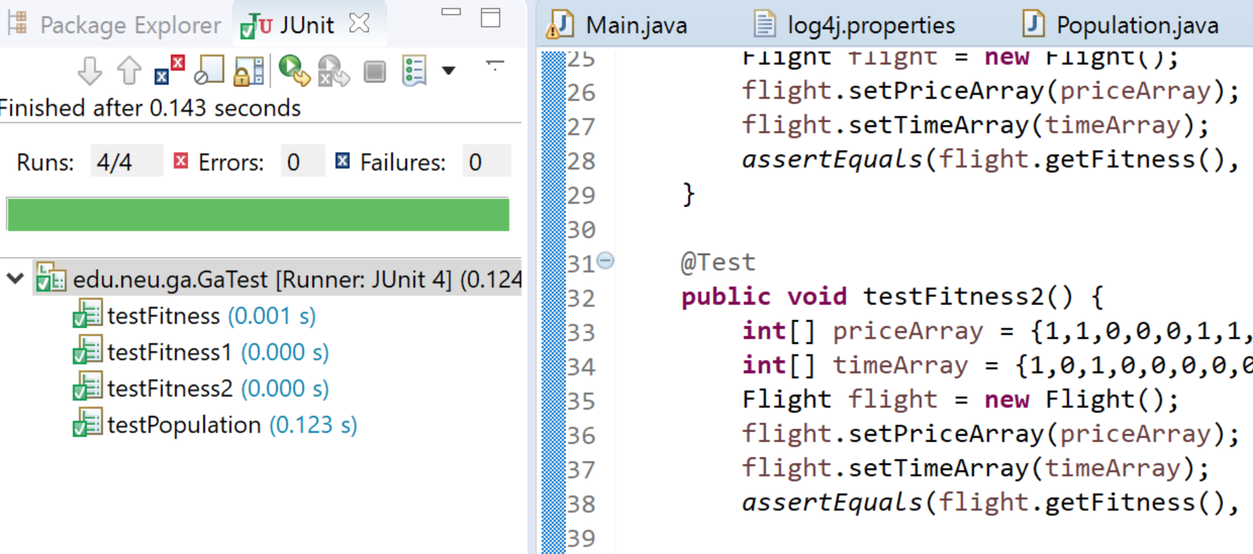
Unit Test Output

Slide 21
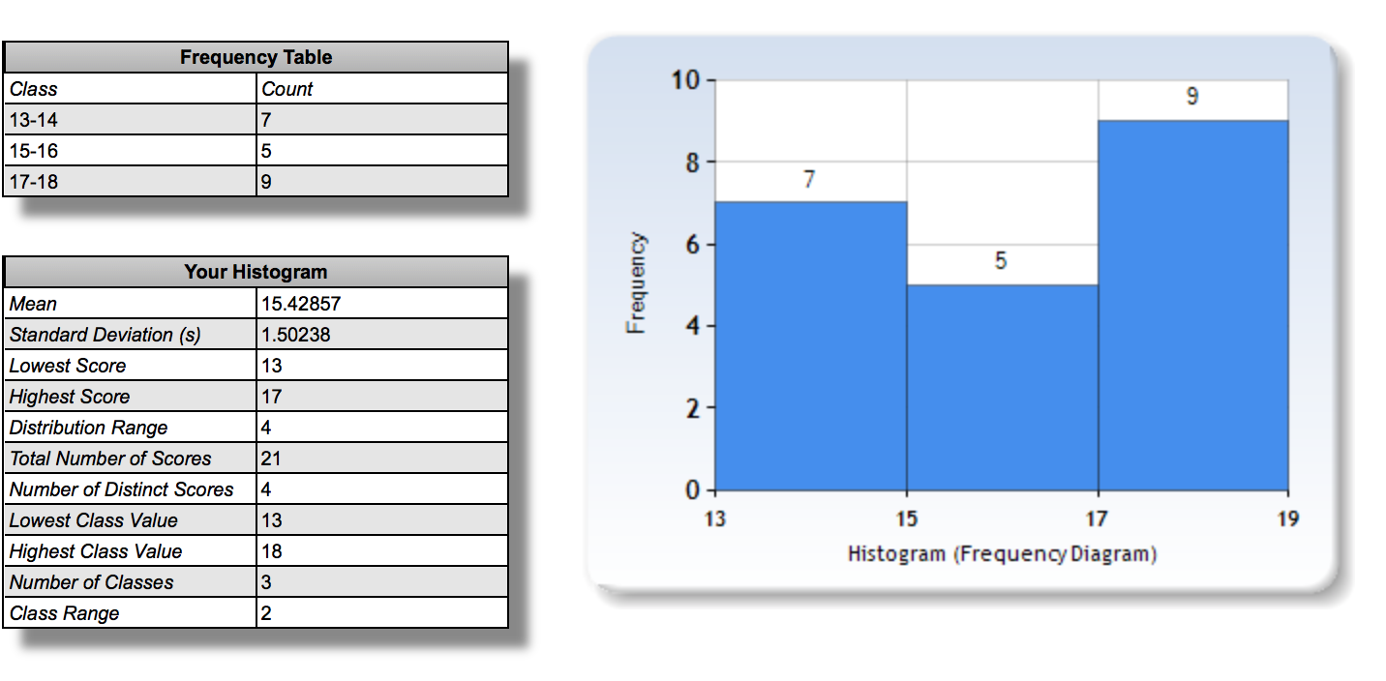
Result(explanation in next slide)

Slide 22
Result
The minimum number of evolutions is 100, but if the fitness levels are not reached the program tends to go beyond 100 to achieve optimum fitness(not necessarily maximum). The largest number of evolutions seen yet was 331.
Our results consist of almost 150 generations.
We took random 21 generation data to prepare histogram.
X-axis consist of range of fitness value and Y-axis consist of number of evaluations.

Slide 23
Conclusion
Genetic algorithms is useful in generating better flight breeds in terms of time and prize.
We, could clearly state that the new generation of flights are getting better in their traits of time and prize.
 | First few generation | Last few generations
Fitness value | 13 | 17
Fare | $400 | $350
Duration | 3.75 hours | 3.0 hours

Slide 24
Thank you

